Slide 1
Inventory Management System
Matthew Dunnage

Slide 2
A brief overview
Create an IMS Using Java and Mysql
Implement a CI pipeline
Present Project

Slide 3
Approach - CI Pipeline
Risk assessment
ERD for database
Project tracking - Kanban boards (Trello)
Source Code - Java (Eclipse), Mysql (Google cloud platform)
Version control system - Git, Github
CI server - Jenkins
Build tool - Maven
Automated Testing - Unit testing (JUnit), Integration tests (Mockito)
Static analysis - SonarQube
Artifact repository - Nexus

Slide 4
Project Tracking
Trello
Would consider using github boards in future
https://trello.com/b/94agYl6X/welcome-to-trello

Slide 5
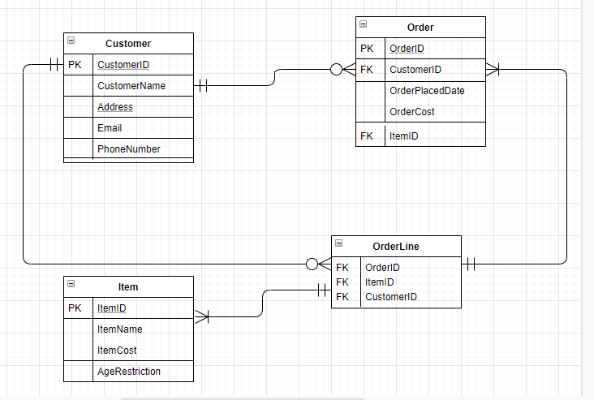
ERD

Slide 6
Source Code
A Brief demonstration...

Slide 7
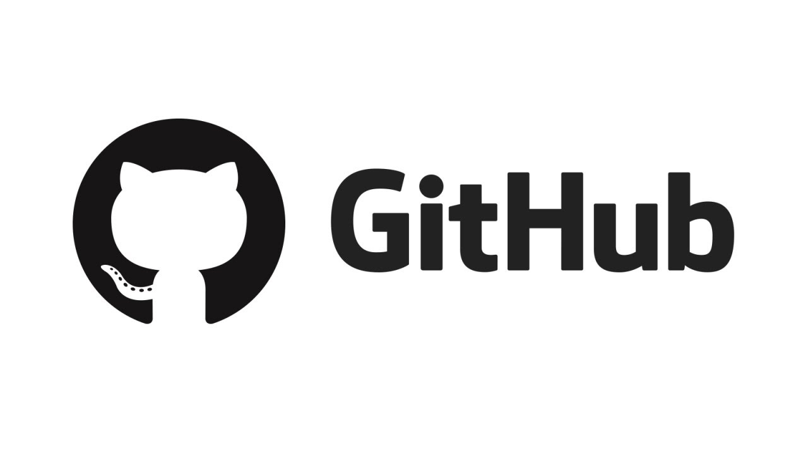
Version Control System - GitHub
https://github.com/MDunnageQA/IMSDB
Made some mistakes - commiting directly to master branch

Slide 8

CI Server - Jenkins
http://localhost:8080/
Makes integrating build, test and deployment tools fast and easy

Slide 9
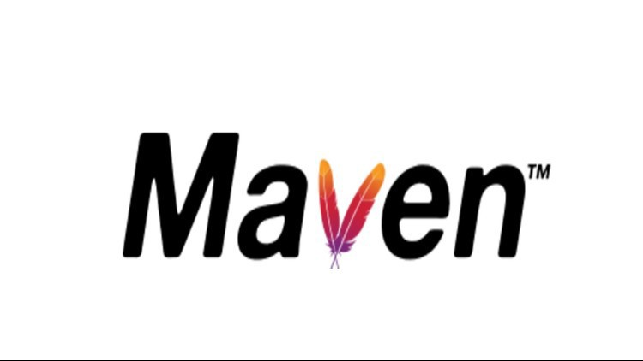
Build Tool - Maven
Provides a uniform build system
Allows projects use of depencies
Unit test reports and coverage

Slide 10


Unit Tests(JUnit) & Integration Tests (Mockito
A Brief demonstration...

Slide 11

Static Analysis - Sonarqube
Code tested before being run
Code is analysed against good practices
Provides suggestions to make code more efficient/better
http://35.242.138.185:9000/

Slide 12

Artifact Repository - Nexus
Allows for easy storage and version control of projects
Integrated with Maven makes dependency management simple

Slide 13
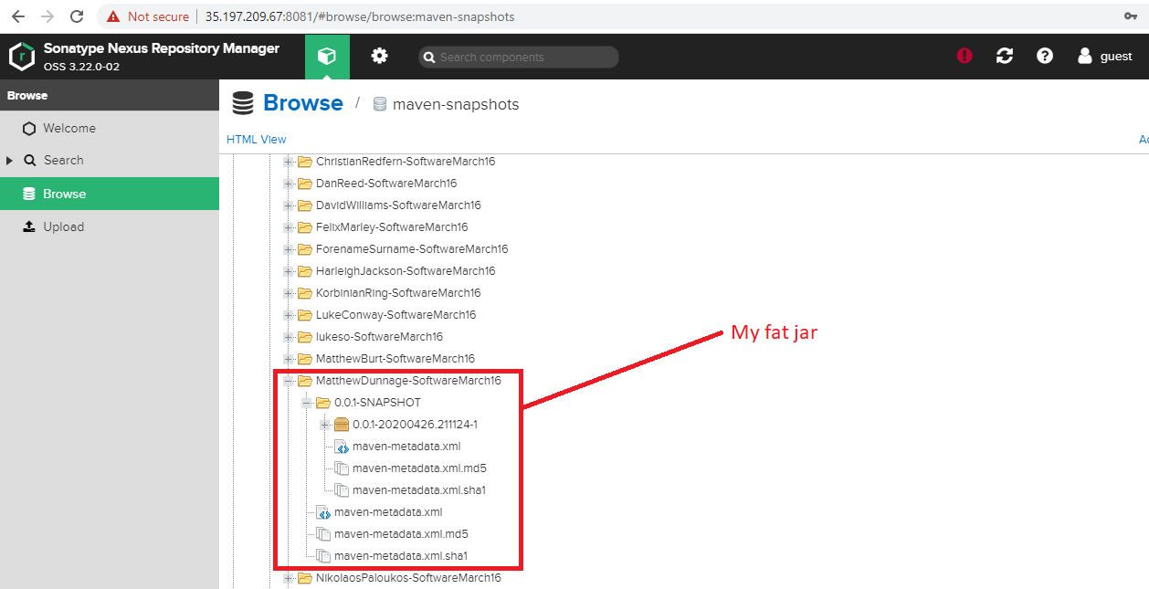
Artifact Repository - Nexus

Slide 14
Journey as a consultant
Before Starting: some programming experience
Never used CI Pipeline
No experience with VCS
Never used Unit testing or integration tests
Greater understanding of build tools
No experience with artifact repositories

Slide 15
In Retrospect
GitHub management
Some issues with Maven halted my progress
Source code could’ve been made more intuitive

Slide 16


